Slide 1
TastyBites Buisness performance Analysis
Prepared By : Rishab Bansal
Data Analyst | Business Analyst

Slide 2
BUSINESS PROBLEM & OBJECTIVES
About TastyBites
TastyBites, a food delivery app operating in multiple cities. The company has noticed that some products generate low profit despite high sales, while others contribute significantly to the bottom line. Management wants to optimize product pricing and promotions to maximize profitability without losing customers.
Key Assumptions
Only past 2 years of data are available.
Discounts cannot exceed 25% as per policy.
Assume profit = Revenue – Cost; delivery costs are not included.
Customers are sensitive to price changes above 10%.

Slide 3
Buisness Objectives
Identify high-profit and low-profit products.
Understand the impact of discounts and promotions on profit margins.
Recommend pricing strategies to increase overall profitability.

Slide 4
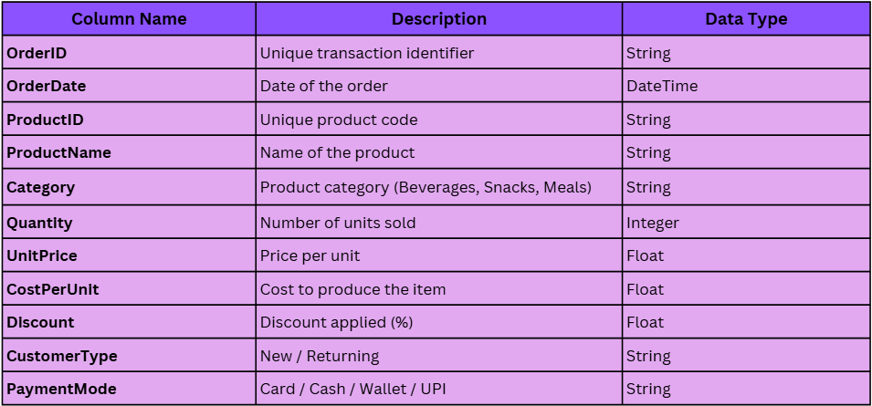
Dataset Given
DATASET OVERVIEW

Slide 5
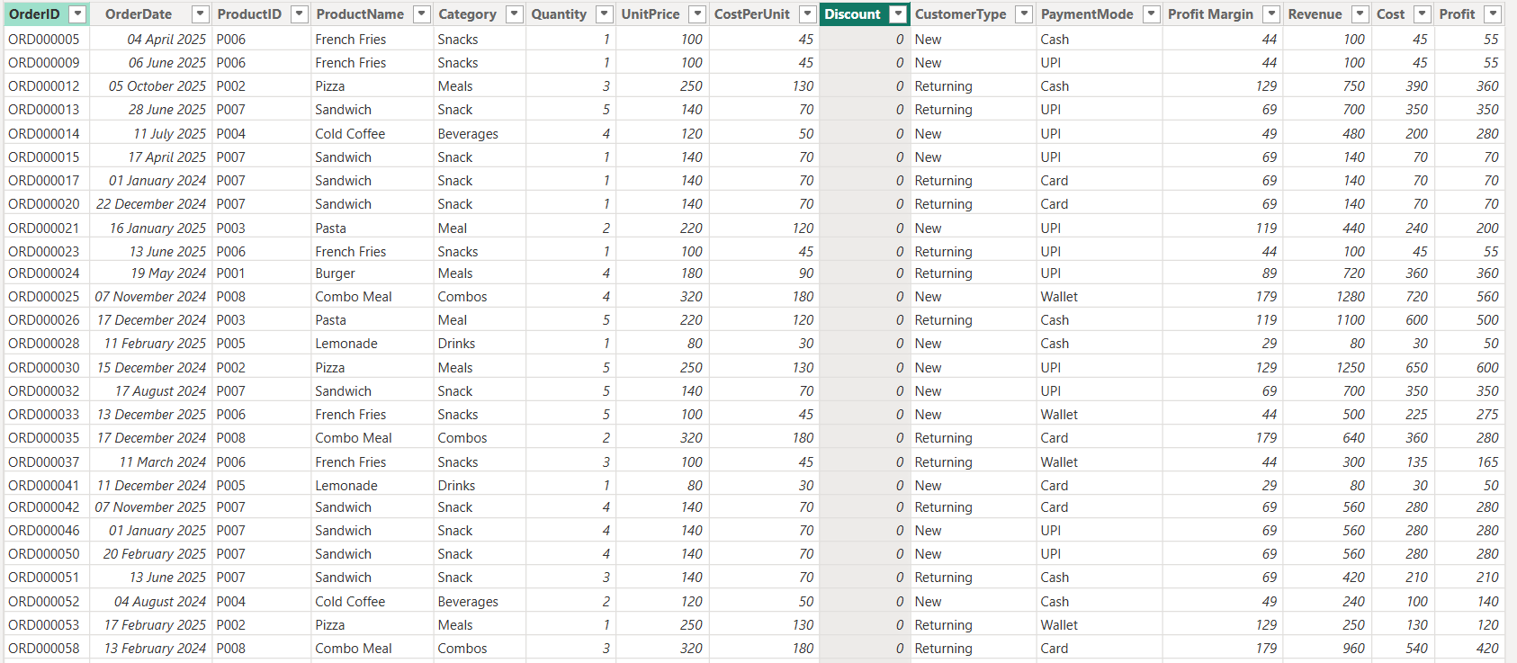
DATASET AFTER CALCULATED COLUMNS

Slide 6
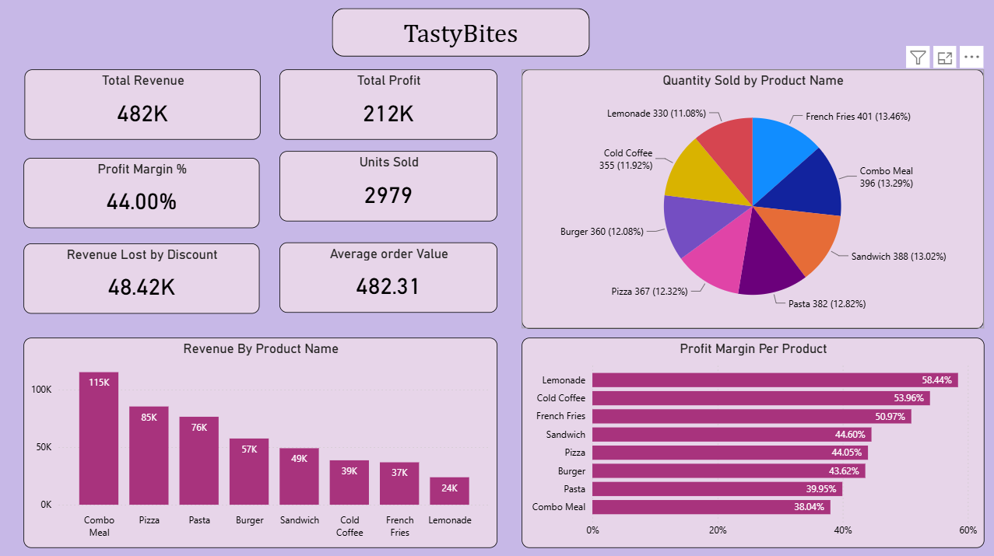
KPI OVERVIEW

Slide 7
Revenue & Profit Leaders by Product
Key Insight: Combo Meal leads in revenue (115K) but has the lowest margin (38%). Lemonade & Cold Coffee have the highest margins (58% & 54%) despite lower revenue. Dual opportunity exists to scale high-margin drinks.

Slide 8
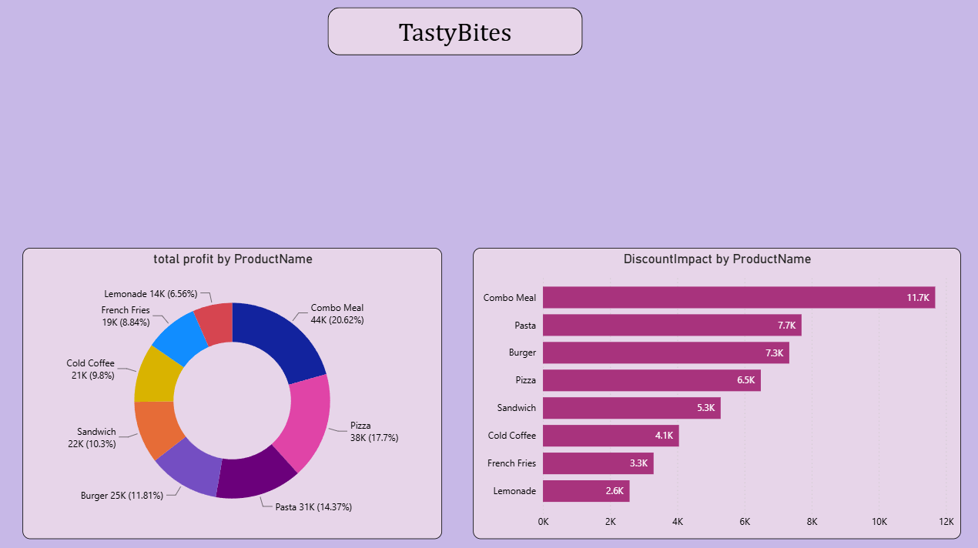
How Discounts Affect Profitability
Key Insight - Combo Meal absorbs 24% of all discount losses (11.7K/48.42K). Since its margin is already the lowest at 38%, further discounting erodes profitability severely. Discounts on Lemonade/Cold Coffee are relatively safe given their 54–58% margins..

Slide 9
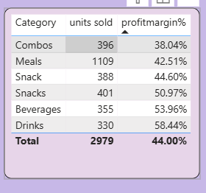
High Volume, Low Profit — The Profitability Trap
Finding: Combo Meal & Pasta sell well (396 & 382 units) but deliver the weakest margins (38% & 40%). Despite high volume, they generate less profit per unit. Optimization of their cost structure or pricing is recommended

Slide 10
KEY INSIGHTS & HIDDEN TRENDS
Combo Meal drives volume but is the least profitable product — needs pricing & discount correction.
Lemonade & Cold Coffee are goldmines — highest margins, underpriced, and undersold.
48.42K was lost to discounts — a 5% reduction in discounting on low-margin items recovers ~5K.
Bundling high-margin drinks with food items is the fastest path to improving average order value.

Slide 11
RECOMMENDATIONS
Bundles Fries + Drink Upsell - Pair French Fries (51% margin) with Lemonade or Cold Coffee (54–58% margin). Offer combo at 8% discount. Both items have high margins, so bundled revenue is still profitable.
Pizza Meal Deal - Add Cold Coffee or Lemonade to Pizza orders at a 5% discount. Pizza is price-sensitive; the drink adds margin. Avg order value increases by ~₹40–60.
Loyalty-Tier Promotions - Offer tiered rewards: 10th order = free Lemonade (58% margin). Incentivizes repeat visits while giving away low-cost, high-margin items. Cost of reward is minimal.
Happy Hour for High-Margin Drinks - Run 3–6 PM promotions on Cold Coffee & Lemonade at 10–12% discount. These items remain profitable even discounted; drives foot traffic during off-peak hours.
Stop Discounting Combo Meal - Combo Meal already has the lowest margin (38%) and the highest discount loss (11.7K). Cap all Combo Meal discounts at 5% max per policy alignment.

Slide 12
Projected Impacts
Recover discount-eroded revenue
Profit gain from pricing adjustment
Profitability improvement
Bundling & promotions

Slide 13
Thank You

